Slide 1

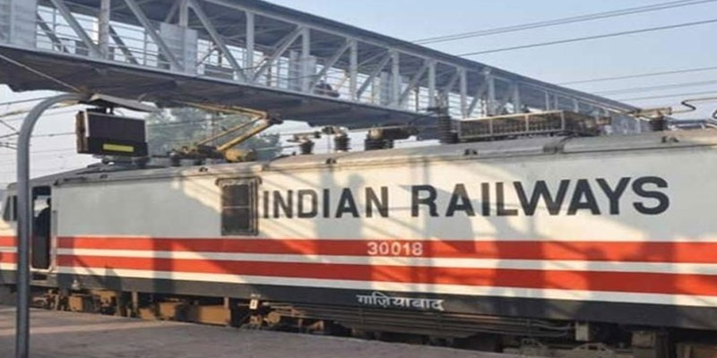
PROJECT TOPIC:
TRAIN TICKET RESERVATION SYSTEM
By: Shivam Kumar Singh
Sap id:590027806
This Photo by Unknown Author is licensed under CC BY-SA-NC

Slide 2
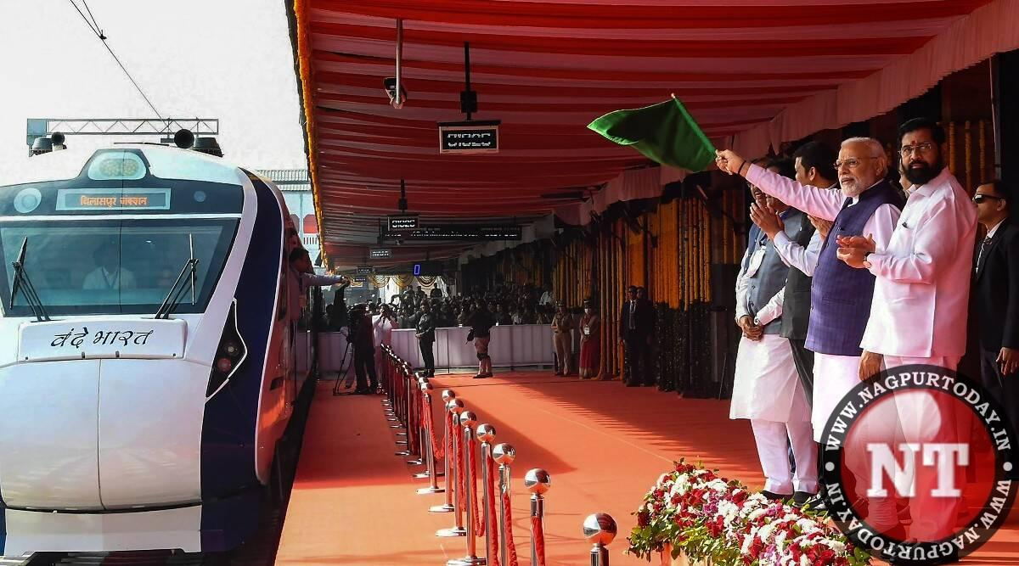
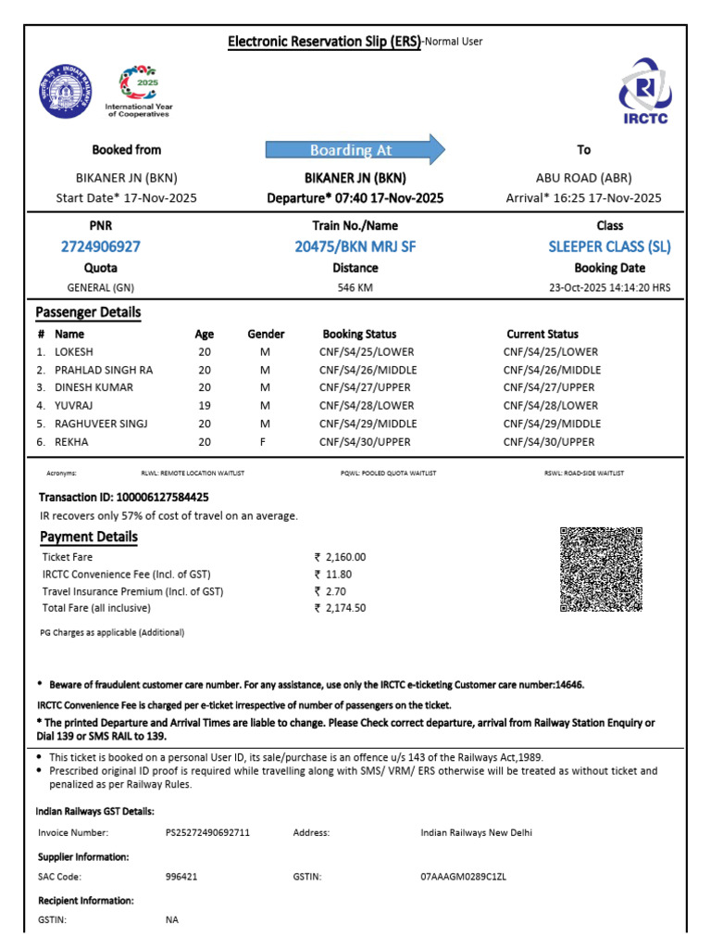
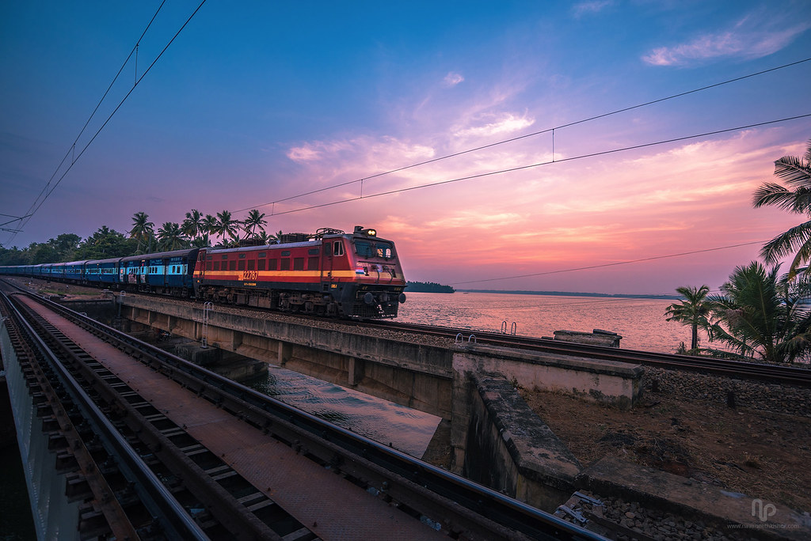
This Photo by Unknown Author is licensed under CC BY

Slide 3

INTRODUCTION:
Project Title : Train Ticket Reservation System
Course : Programming in C
Course Faculty : Mr. Prashant Trivedi
University : UNIVERSITY OF PETROLEUM AND ENERGY STUDIES(U.P.E.S)
School : School of Computer Science
Date : 01/12/2025

Slide 4
ABSTRACT:
This project presents a Train ticket reservation system made by learning concepts in programming in c .
The goal of this project is to allow user to book train ticket by entering his/her information like their name , age , station for boarding the train to the destination ,in which he train he want to book ticket and how much tickets he want to book and what will be the fare of his ticket/tickets. The project integrate many concepts like input/output switch case . And after applying all this condition the code in the project will print passenger details along with his boarding point ,destination ,total fare etc , and n.o of seats available or waiting etc

Slide 5
Problem Definition
Our country’s railway system manages a large number of passengers daily . The code is simplified model of how the I.R.C.T.C website book tickets for large number of passengers daily and a this code shows a small trial to book tickets.
Asks for user choice whether he wants to book tickets/wants to check seats availability or if tickets are booked he want to cancel the train tickets.
Allows passenger to enter personal and journey details.
Displays to enter train in which passengers wants to book the ticket.
Calculates total tickets cost.
Manages seats available and waiting list.
Displays printed format of ticket.

Slide 6
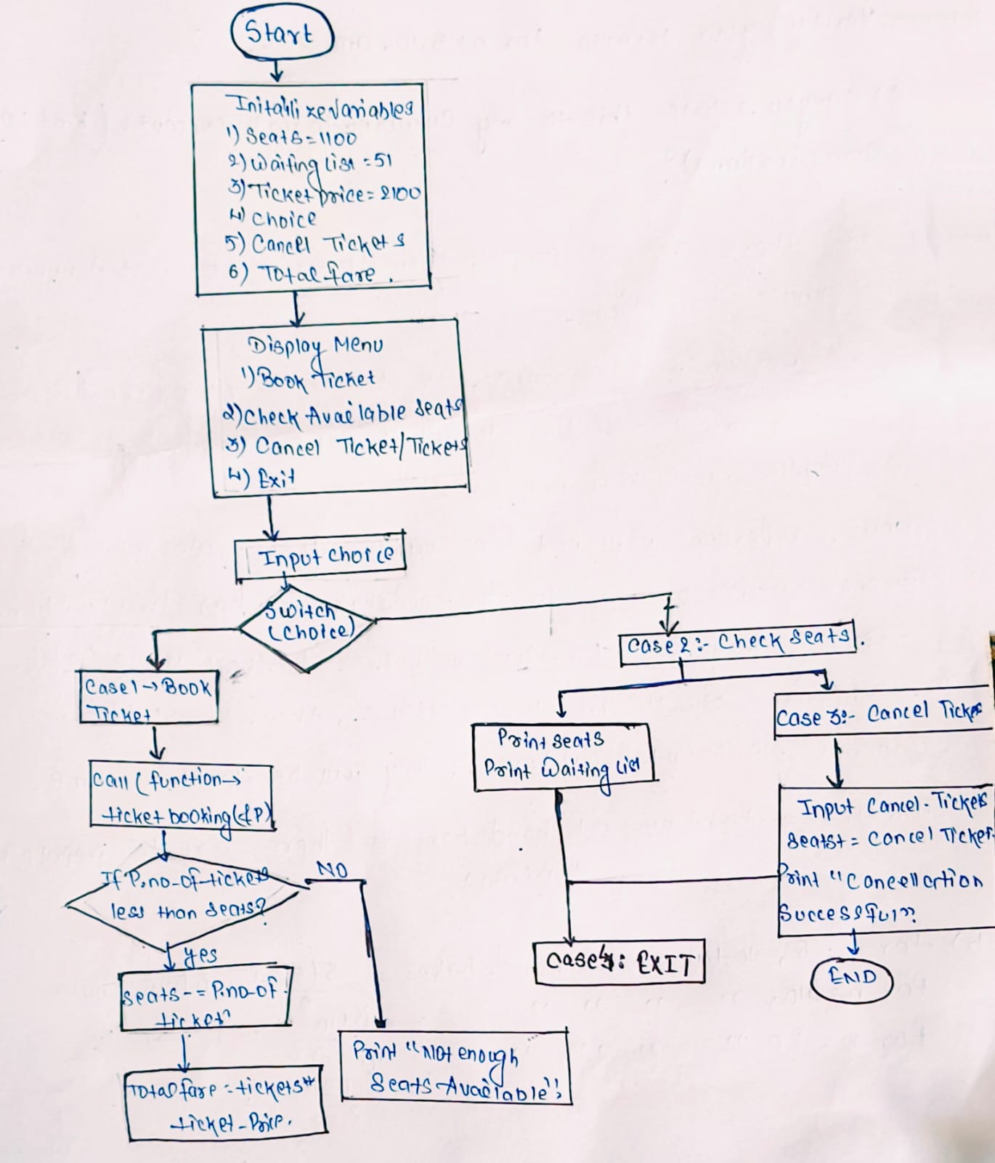
SYSTEM DESIGN
FLOWCHART

Slide 7
SYSTEM DESIGN
ALGORITHM
1)Start
2)define structure details for passenger’s details:
Char passenger first name[51];
char passenger middle name[21];
char passenger last name[21];
int age;
char train name[21];
int pnr n.o;
char From[21];
Char To[21];
int n.o of tickets;

Slide 8
IMPLEMENTATION DETAILS
Important Snippets
1)Structure for details
Struct details{
char name[51];
Int age;
Char train name[21];
Int
Char From[21];
Char To[21];
Int number of tickets;

Slide 9
2)Declare a void function for taking input of details of passenger
3)In main function declare variables int choice , canceltickets , total fare
Declare and initialize variables seats=1100 , waiting list=51 ,ticket price=2100;
4)Display a message “Indian Railway Welcomes You”
5)Use do – while loop repeat until user choose exit option(i.e case 4)
In the loop print menu a)show menu:
1)book ticket
2)check available seats
3)cancel ticket
4)exit
and
print “enter your choice” and take input choice
Use switch case for choice

Slide 10
6) If choice is 1(book ticket) call ticket booking(&p); to collect all passenger’s details if request tickets are less than equal to seats(tickets<=seats);
*seats=seats-p.no of tickets
*total_fare=p.no of tickets*tickets price; print booking confirmation and passenger’s details.
*else if requested tickets<=seats + waiting list
*tickets in waiting=p.no of tickets-seats waiting list-=tickets in waiting
*seats=0;
*print waiting list message else; print no tickets availabilty message

Slide 11
7) Case 2: If choice is 2: print available seats and waiting list count
8) If choice is 3: ask user to how many tickets he/she wants to cancel
*seats-=cancel tickets
*print updated seats.
9)If choice is 4: print thank you message
Exit lop
10) end

Slide 12
TESTING & RESULTS
Test Case Examples:
1) Valid booking , seats available -: Ticket Generated
2) Seats not available : Added to waiting list

Slide 13
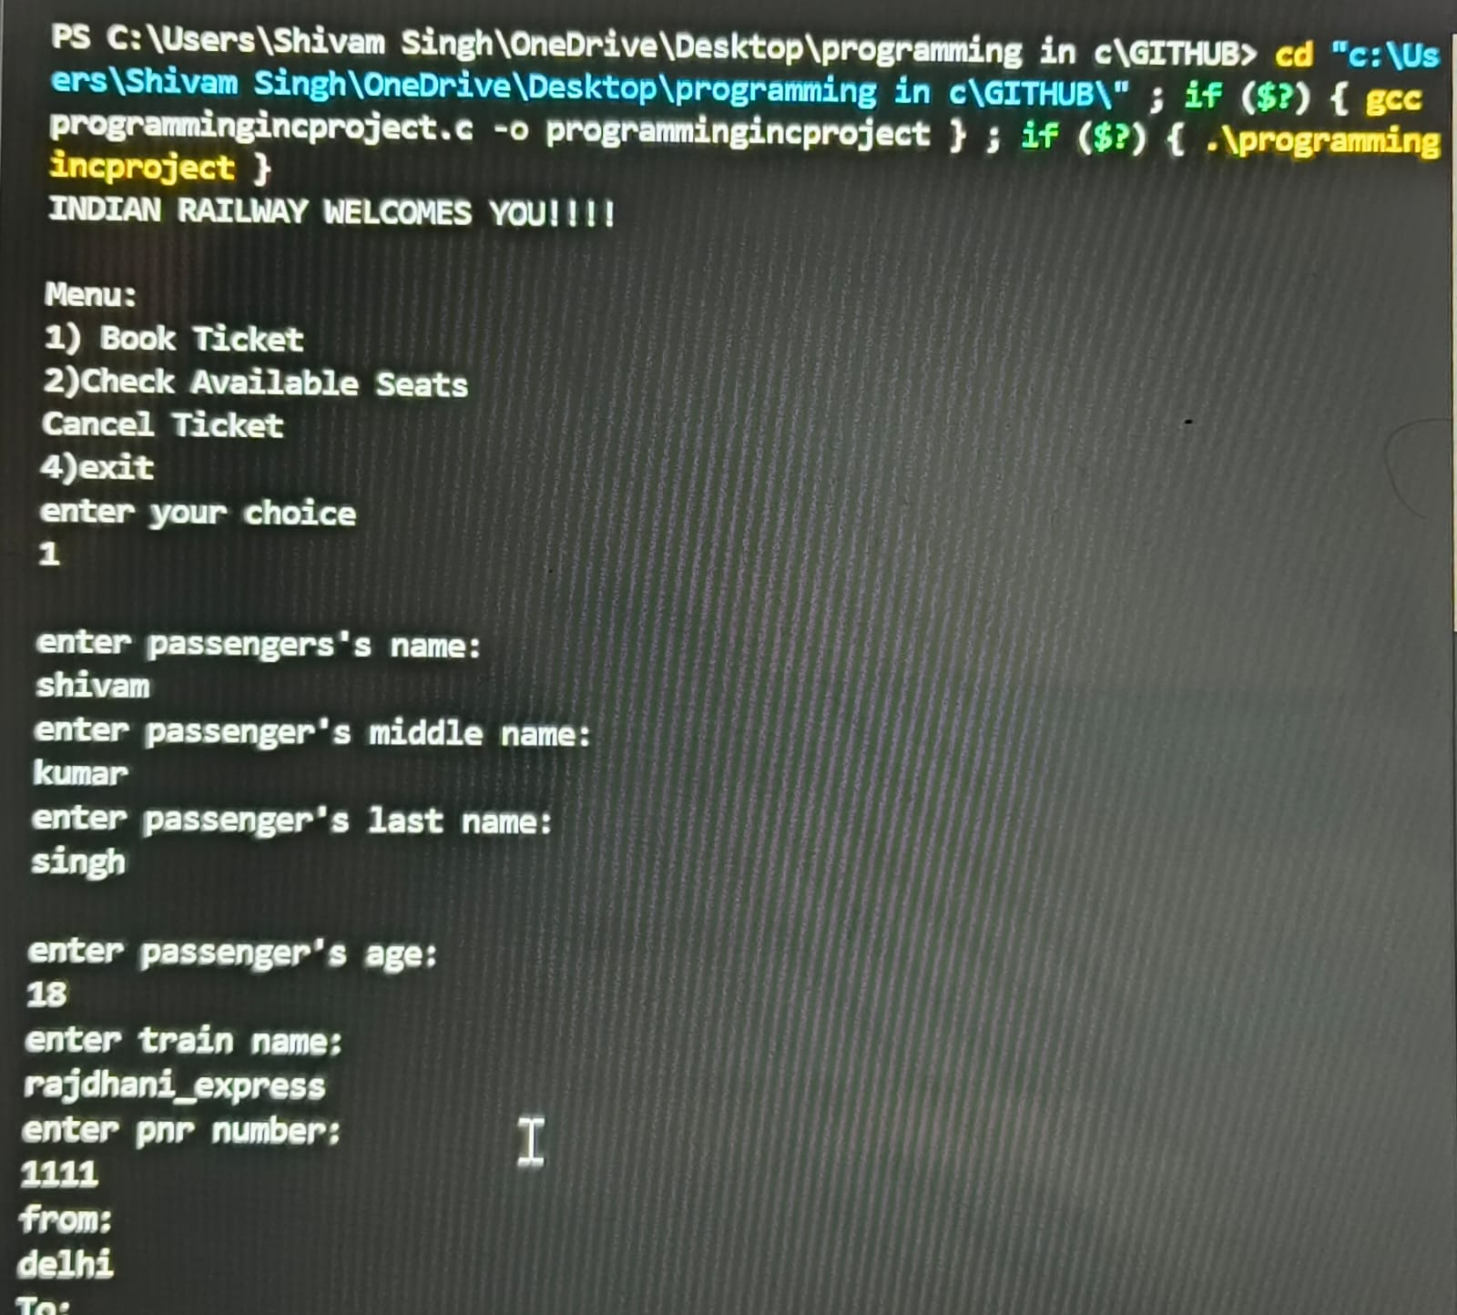
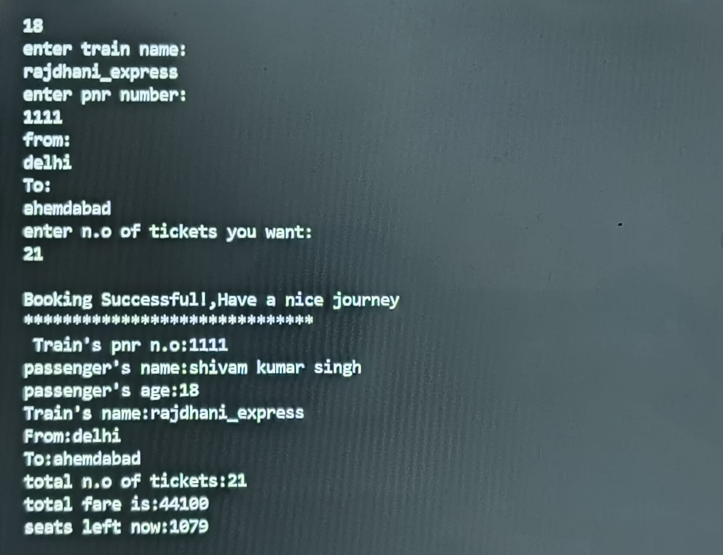
3) EXECUTION SCREENSHOT

Slide 14
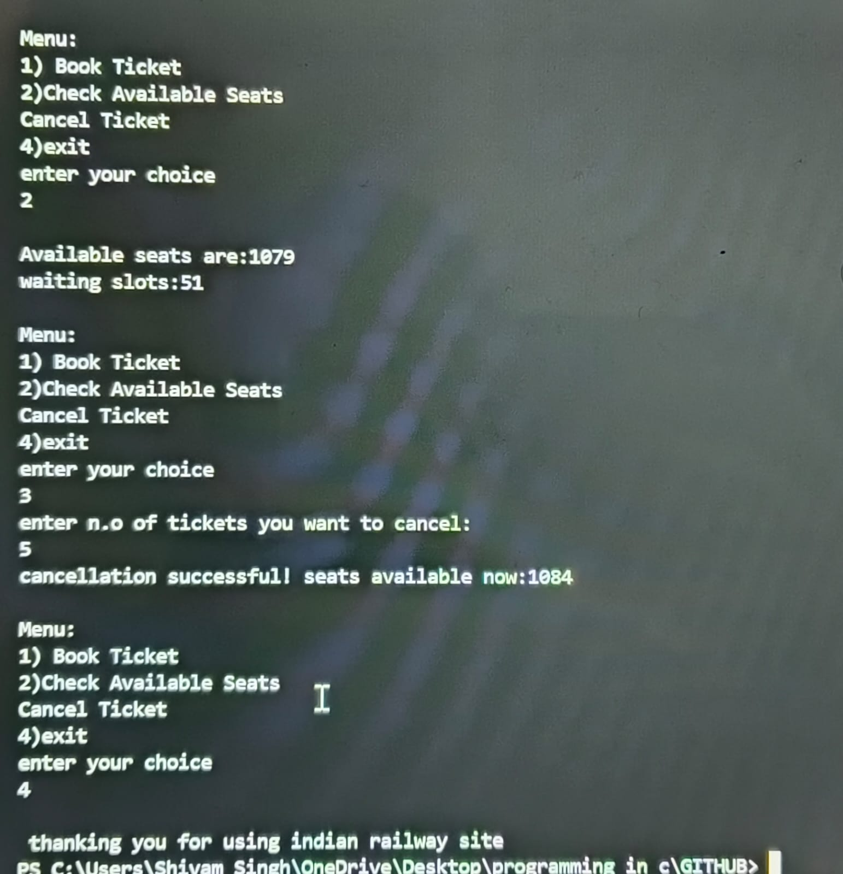
EXCUETION SCREENSHOT

Slide 15
CONCLUSION: The train ticket reservation system code suceessfully performs booking my tracking passenger’s inputs ,caluclates fare and generated ticket in printed format
FUTURE ENHANCEMENTS:
1)Add real time database storage
2)Include details for passenger of each ticket
3)Add features of showing passenger’s seat n.o and his compartment
4)Introduce multiple train classes like general ,1st a.c , 2nd a.c, 3rd a.c etc in ticket
5)introduce time of departure and time of arrival also in ticket
6)introduce distance of destination from boarding station
7)Introduce user authentication
REFERENCES:
1)Class Notes

Slide 16
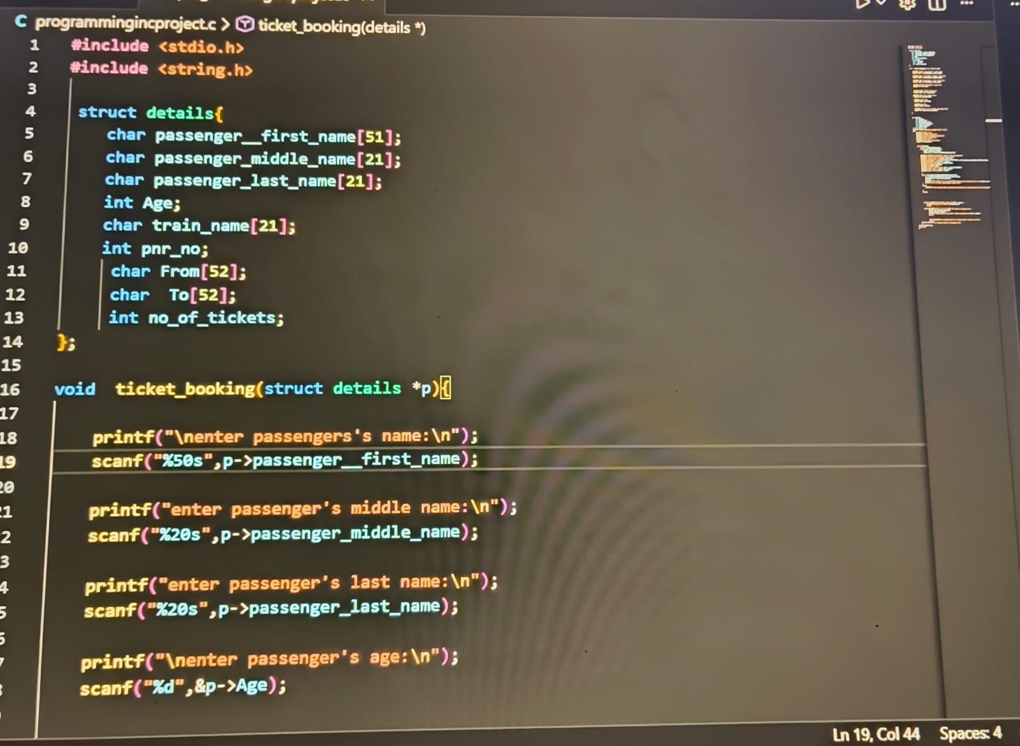
APPENDIX

Slide 17
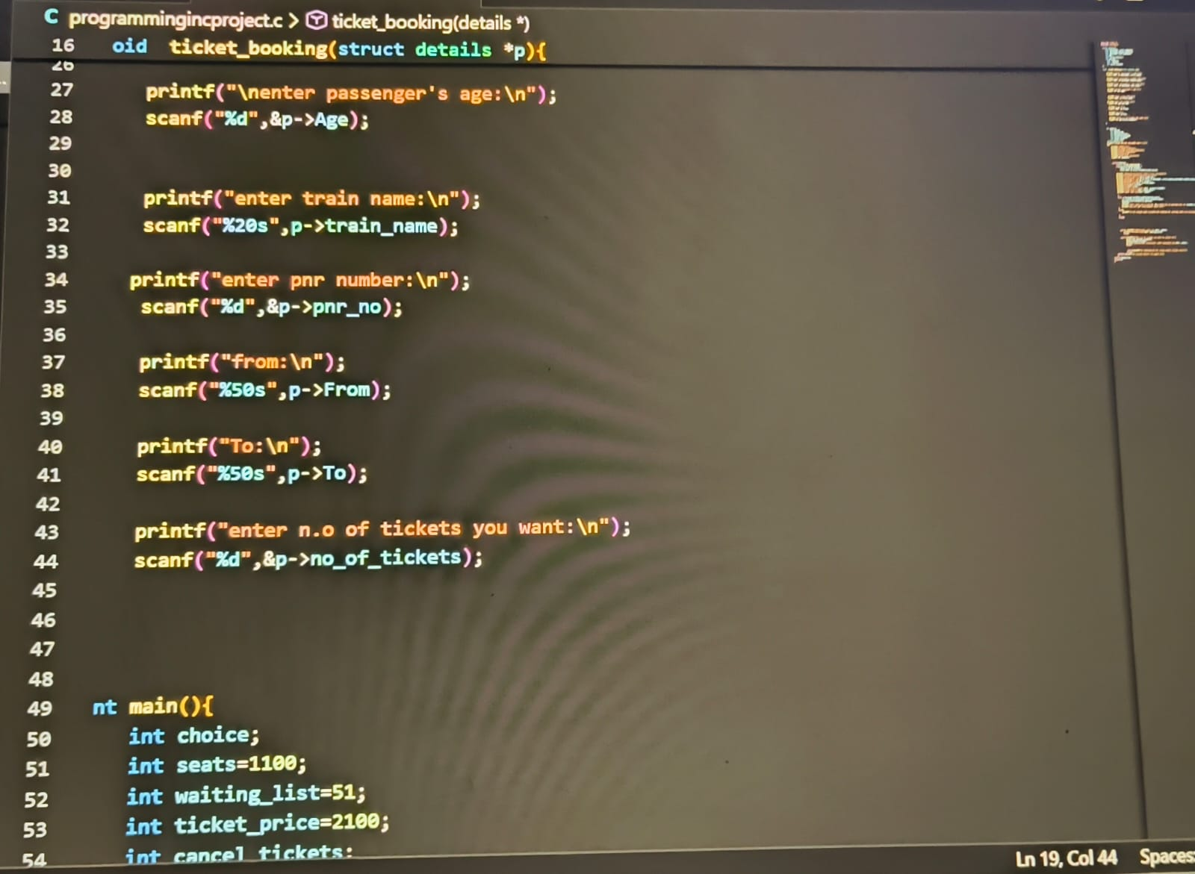
APPENDIX

Slide 18
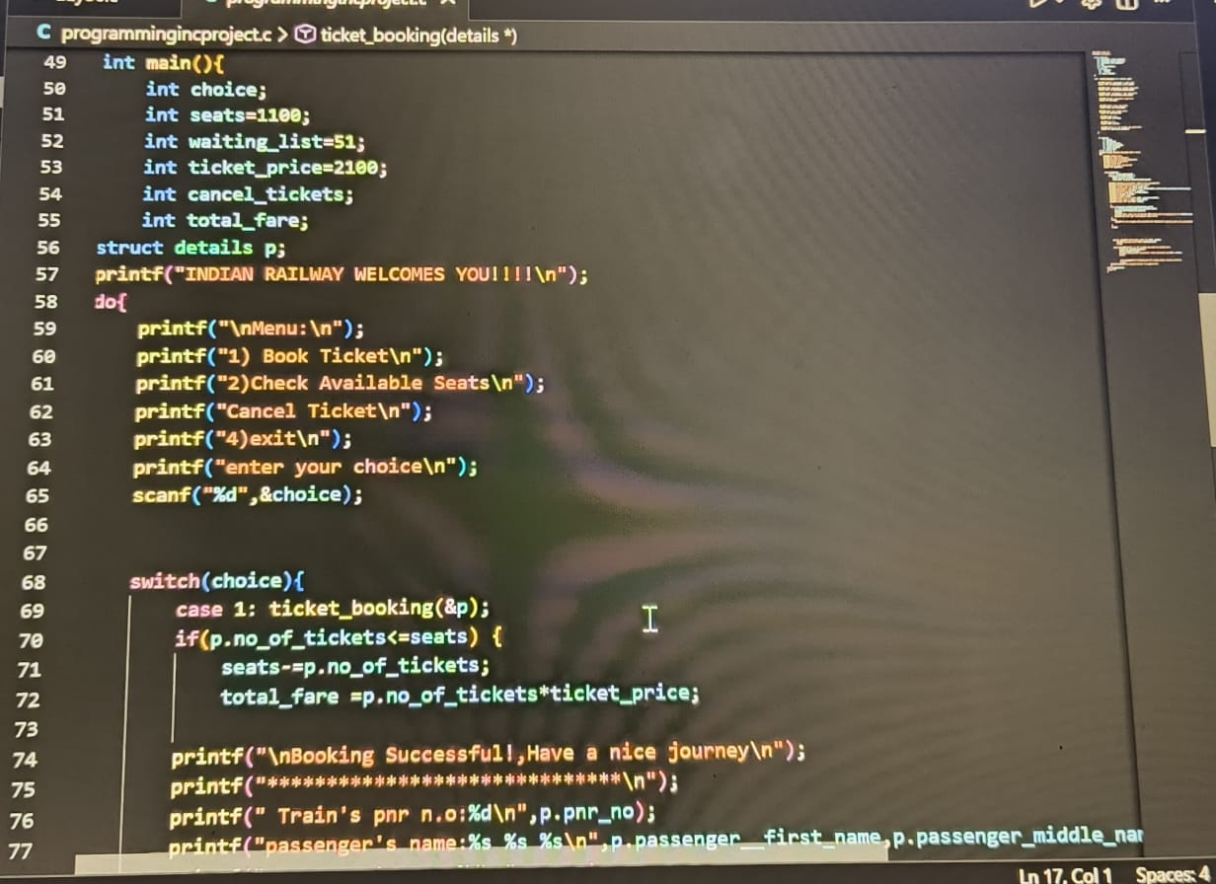
APPENDIX

Slide 19
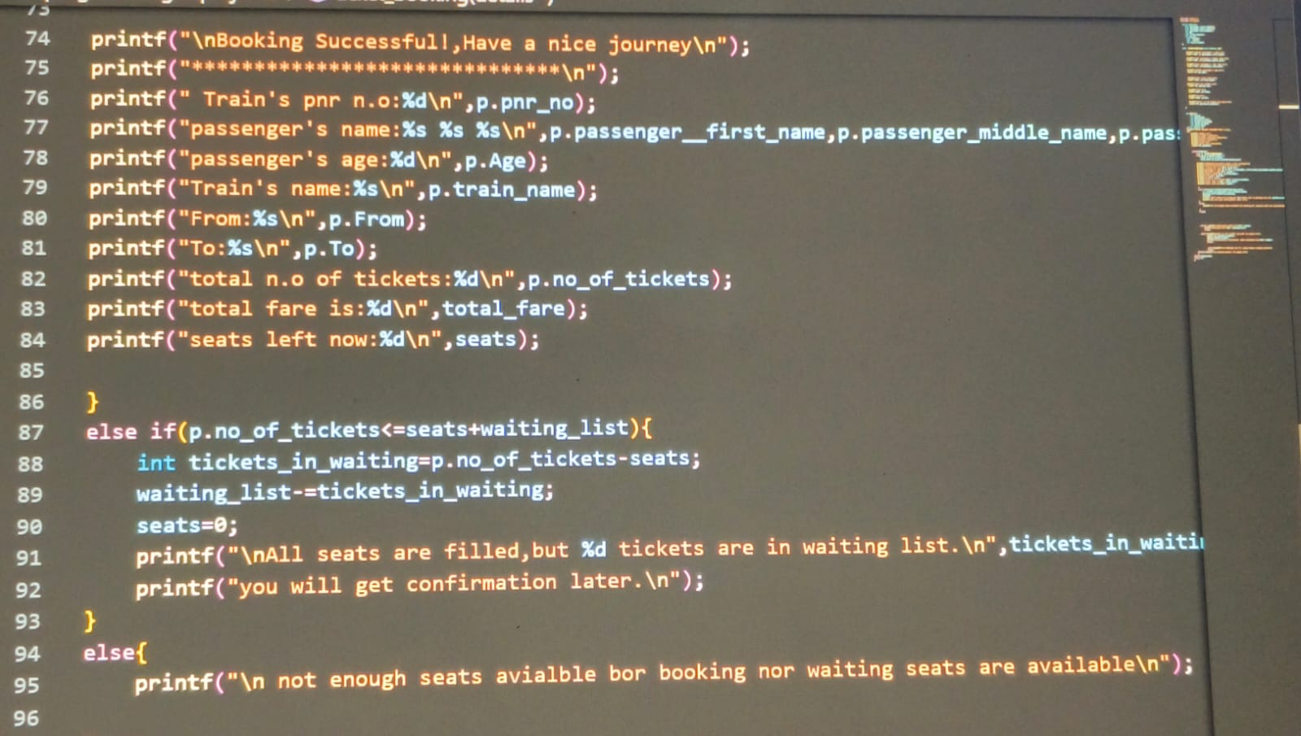
APPENDIX

Slide 20
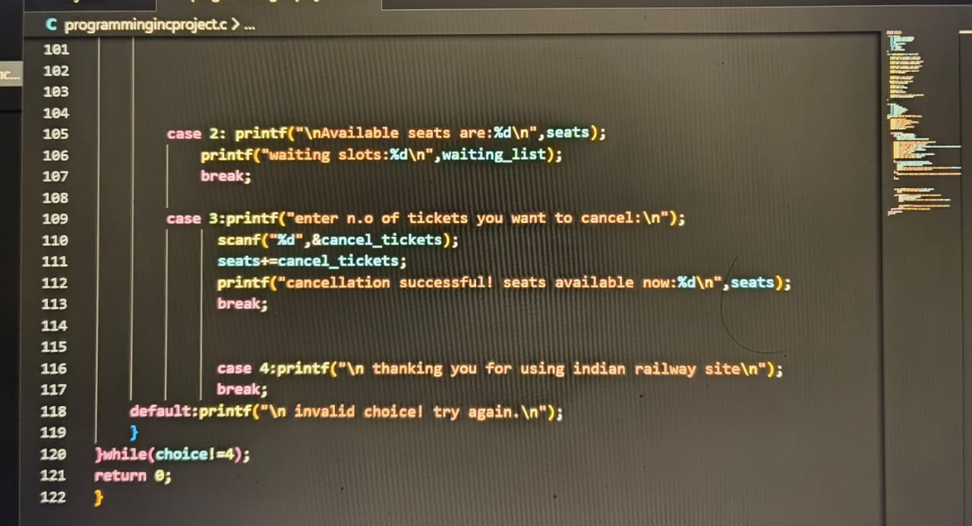
APPENDIX

